Slide 1



Implementing Transformer with Python & PyTorch
Quang Duong

Slide 2
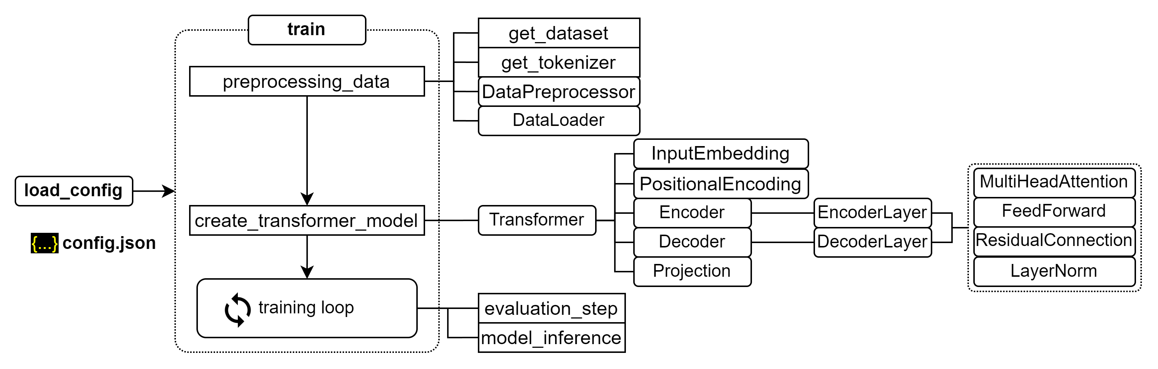
Training process for transformer

Slide 3
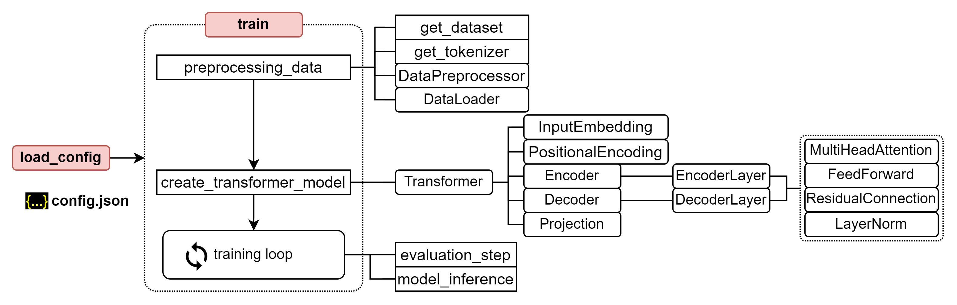
Training process for transformer

Slide 4
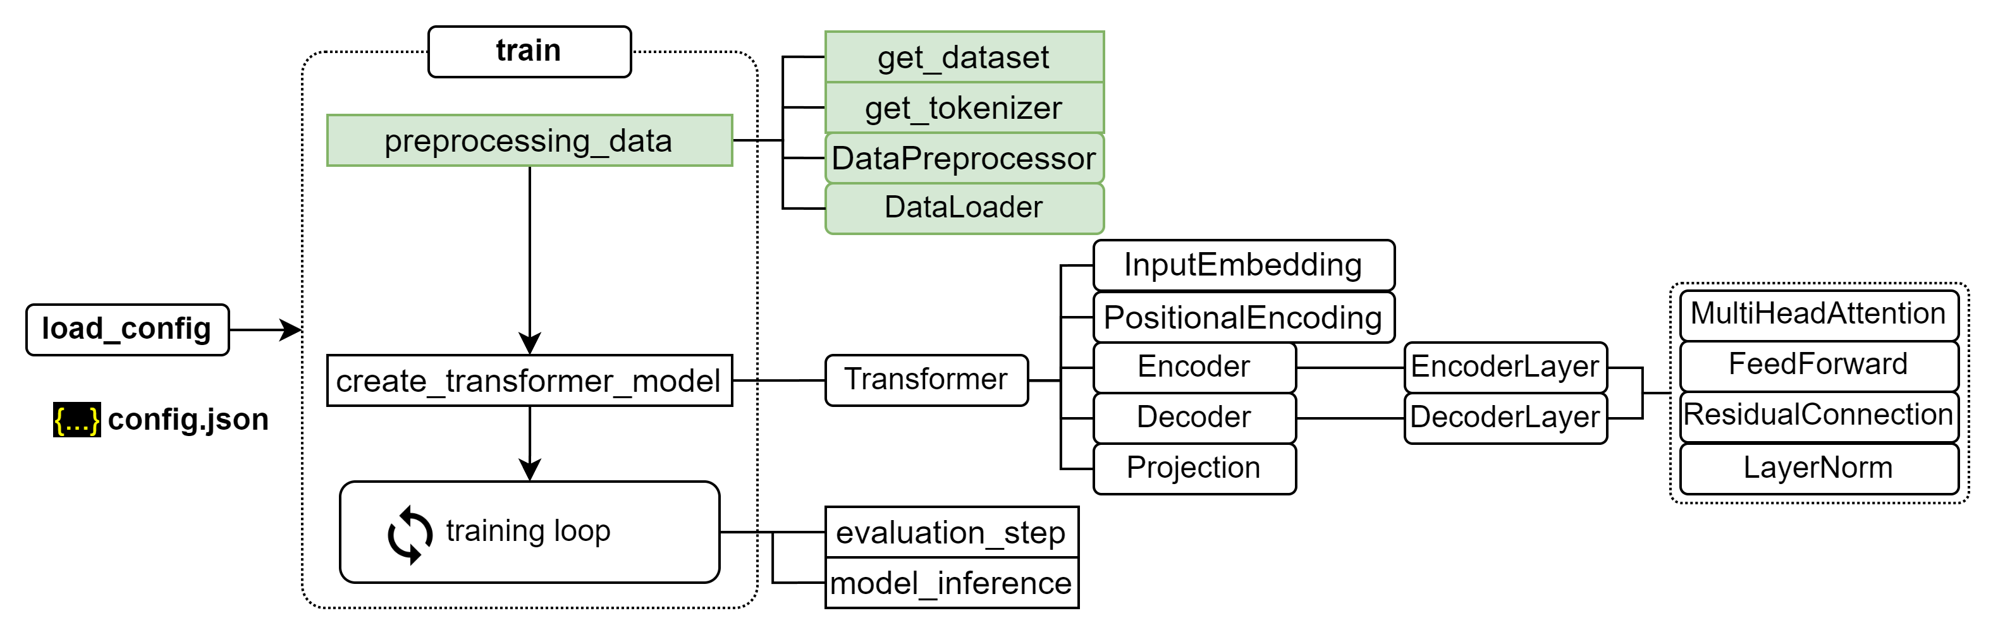
Training process for transformer

Slide 5
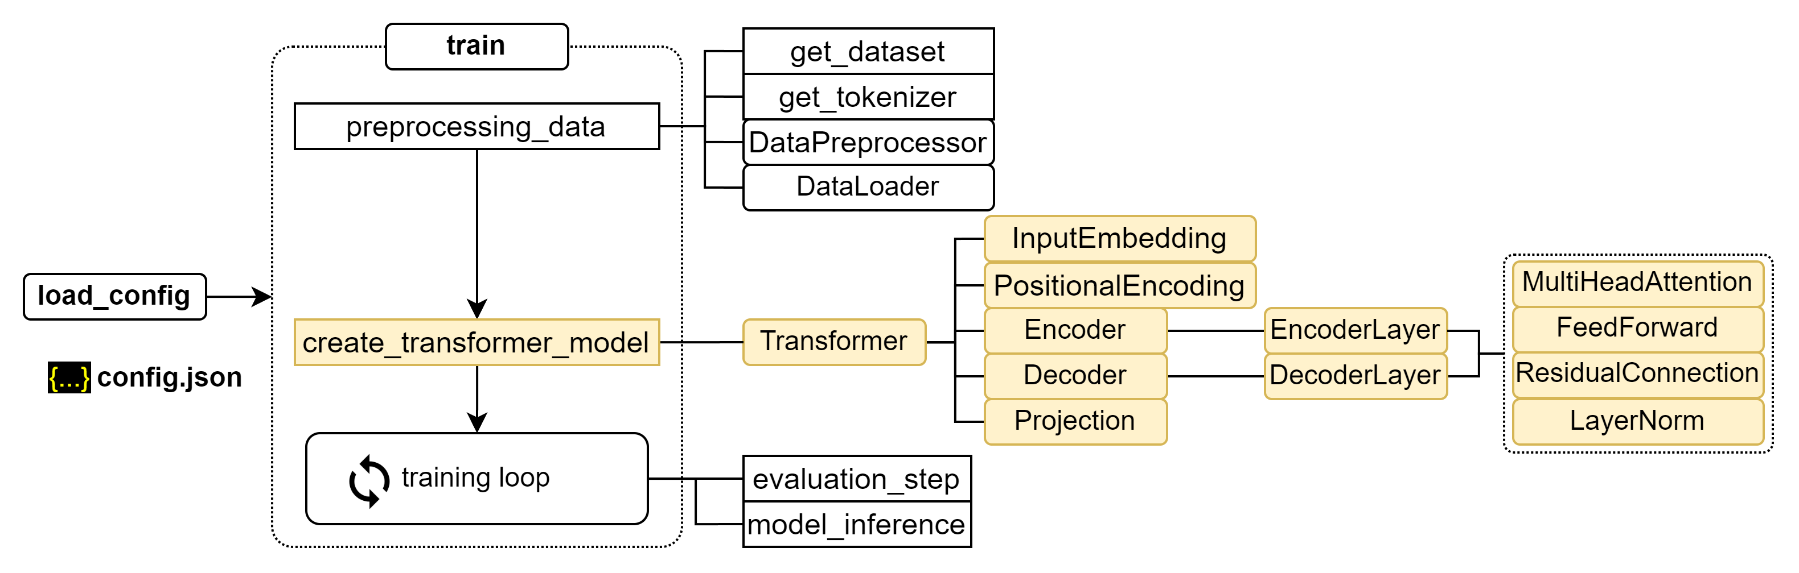
Training process for transformer

Slide 6
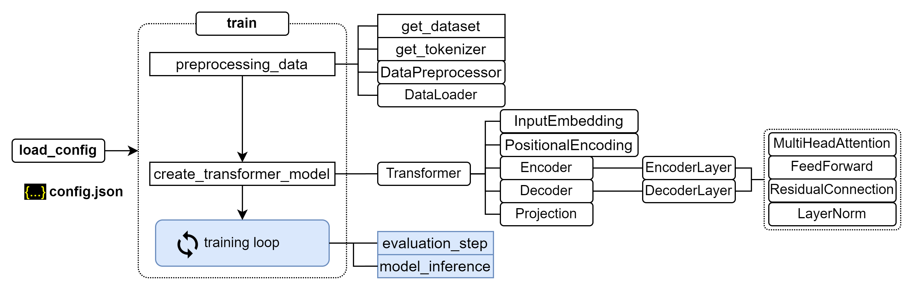
Training process for transformer

Slide 7
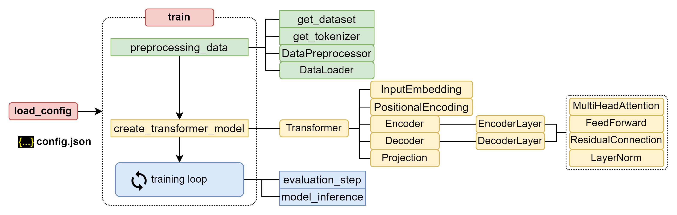
Training process for transformer

Slide 8
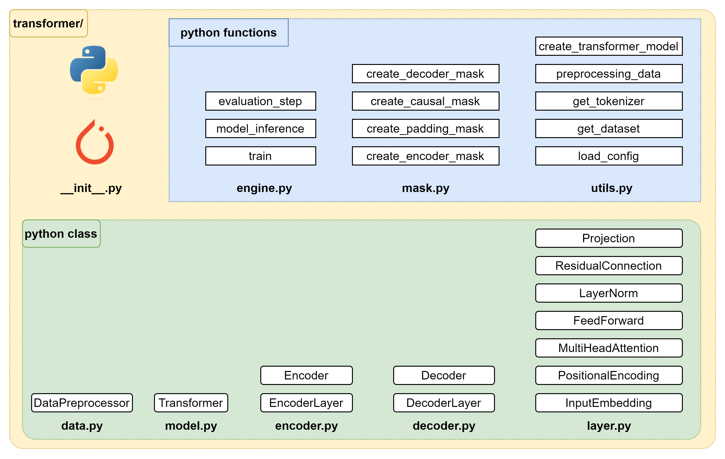
Building Transformer package

Slide 9
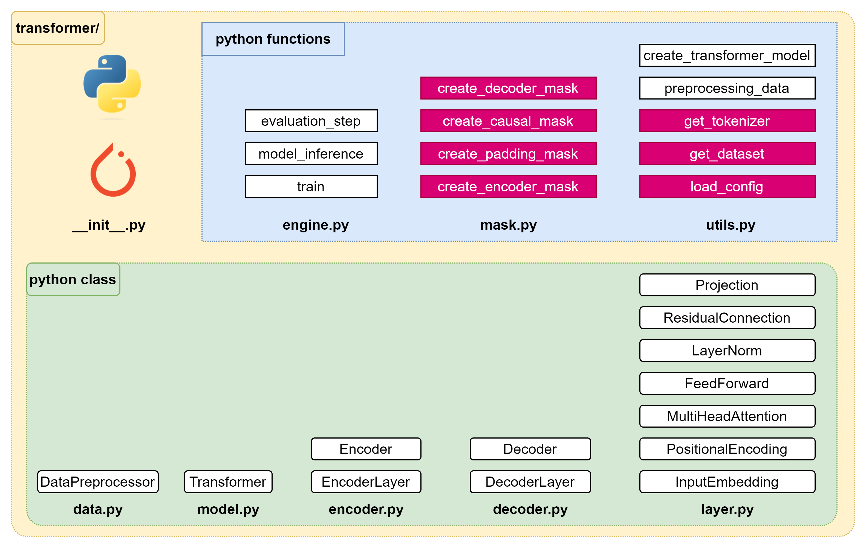
Implementation – Plan of attack (1/4)

Slide 10
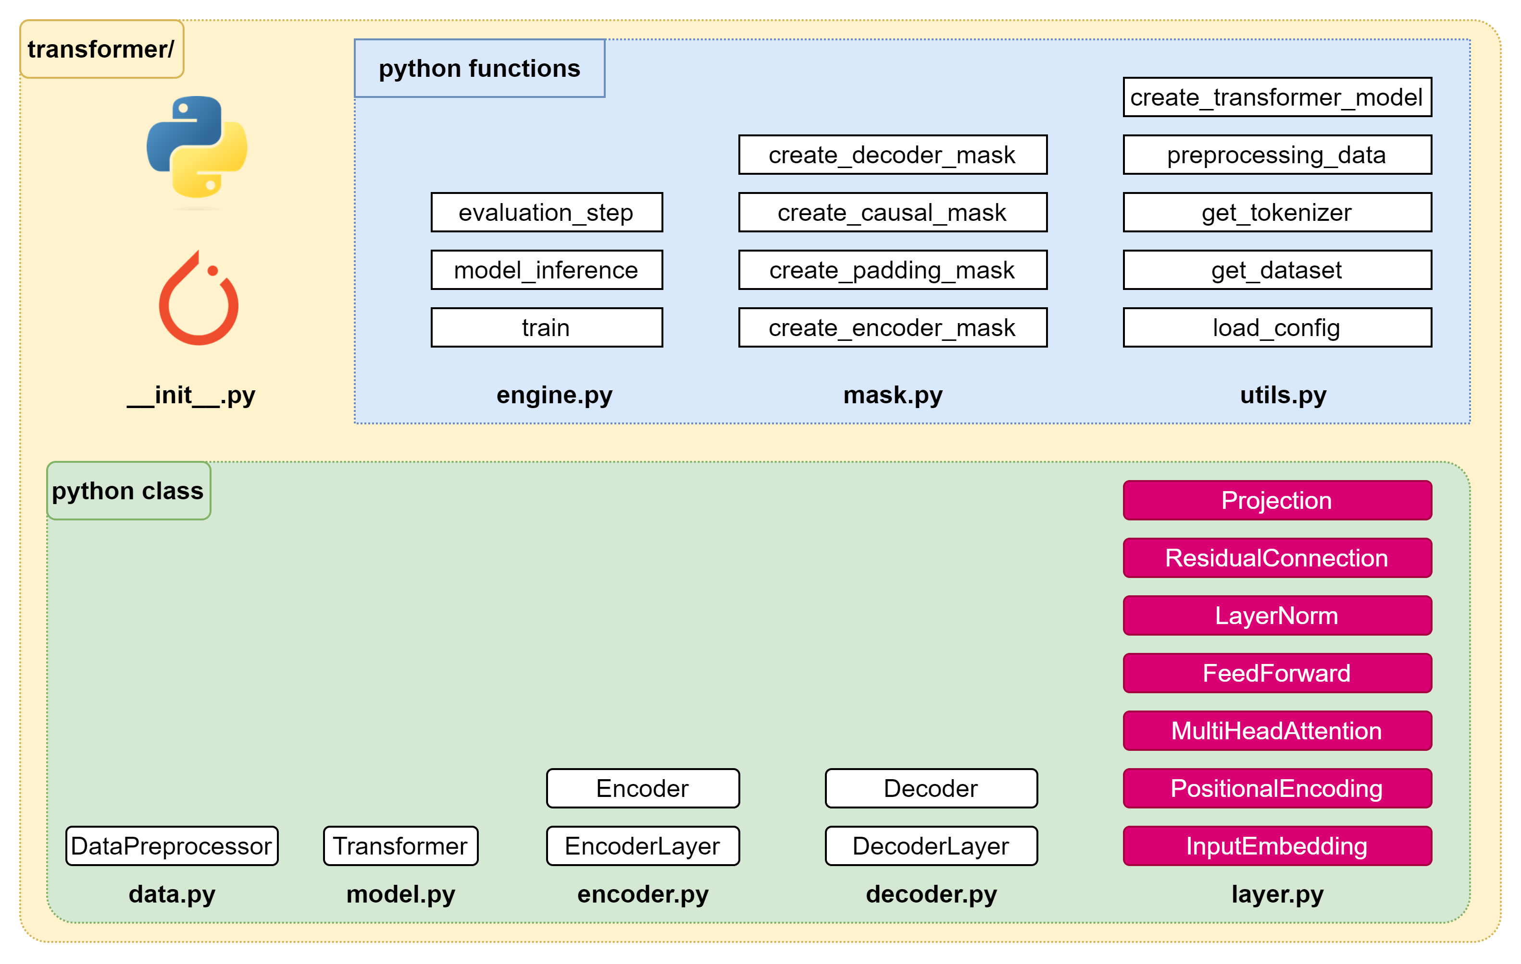
Implementation – Plan of attack (2/4)

Slide 11
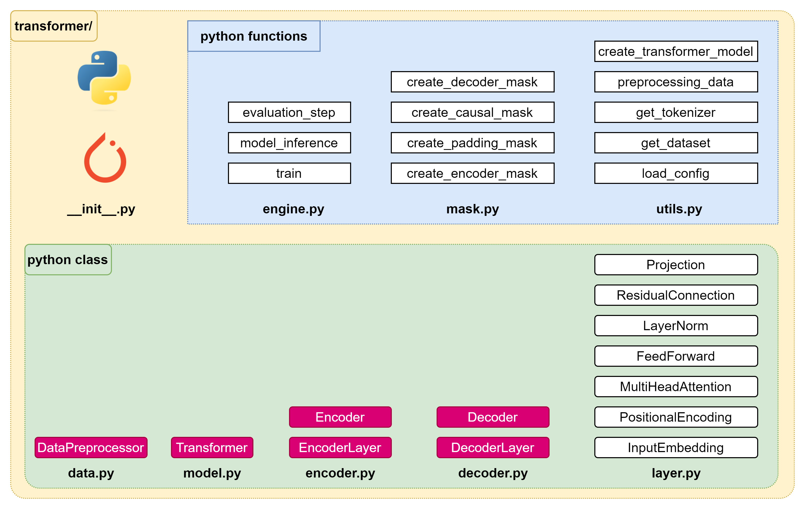
Implementation – Plan of attack (3/4)

Slide 12
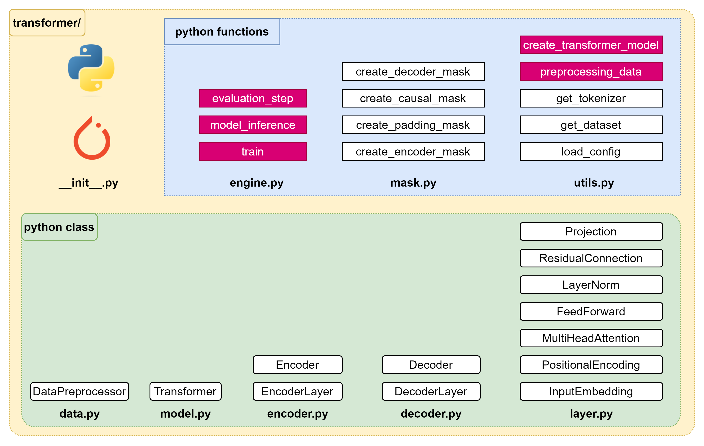
Implementation – Plan of attack (4/4)

Slide 14
Implementation – Plan of attack (1/4)

Slide 15

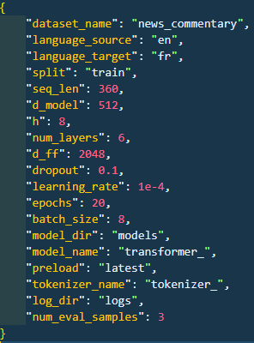
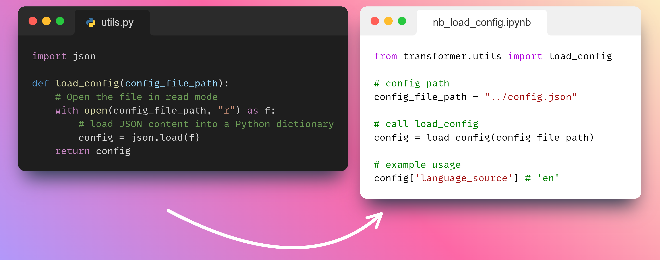
Utils – Load config

Slide 16
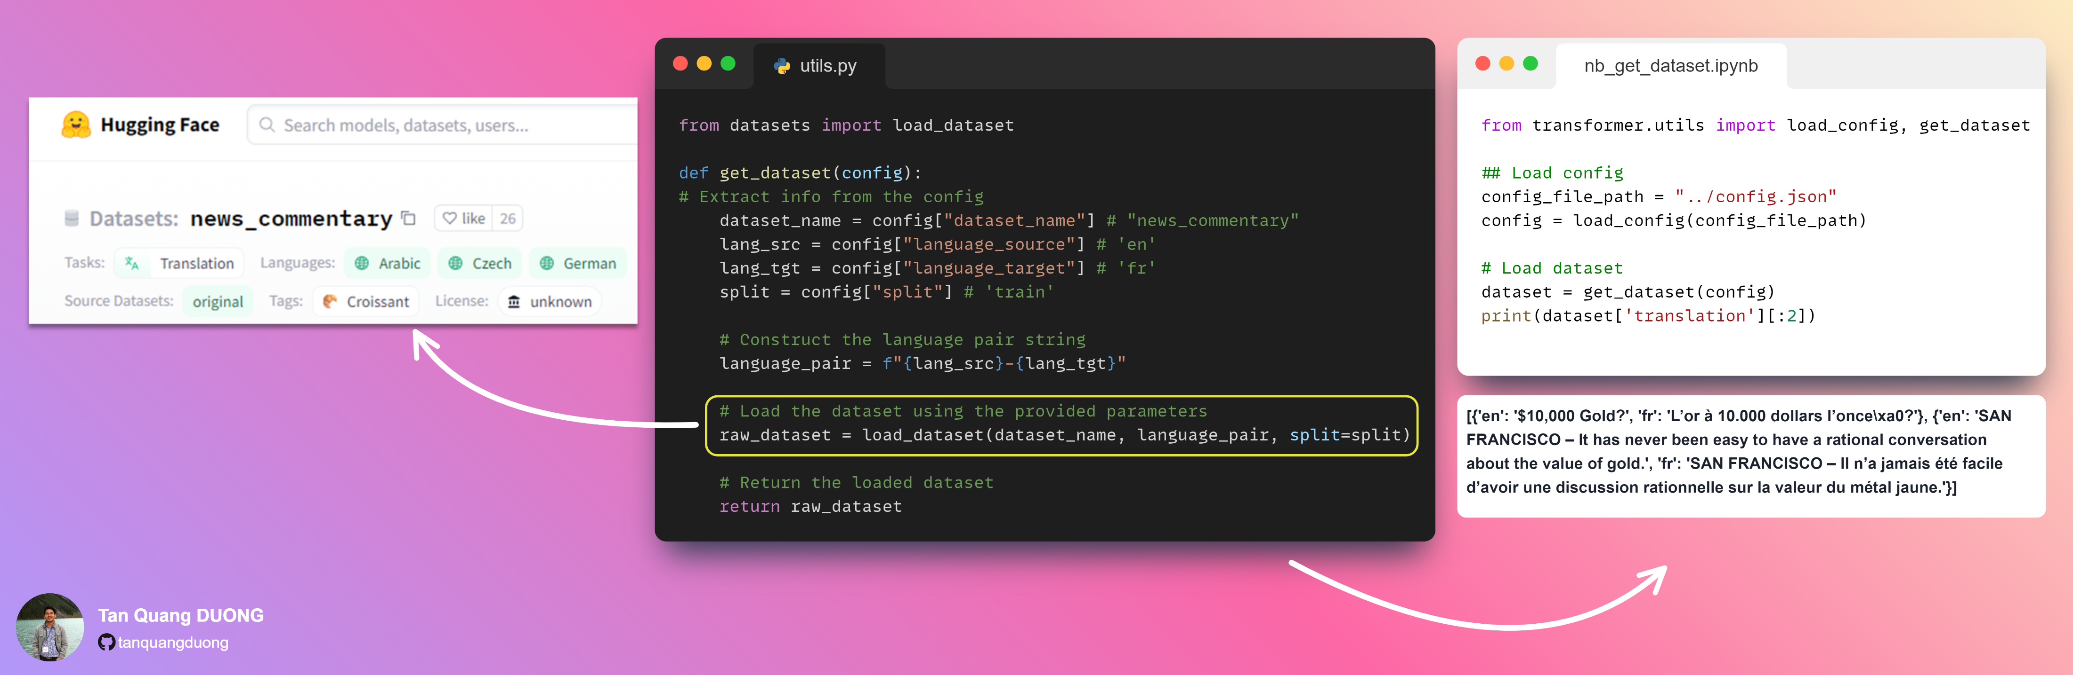
Utils – Get dataset

Slide 17
Utils – Get Tokenizer

Slide 18
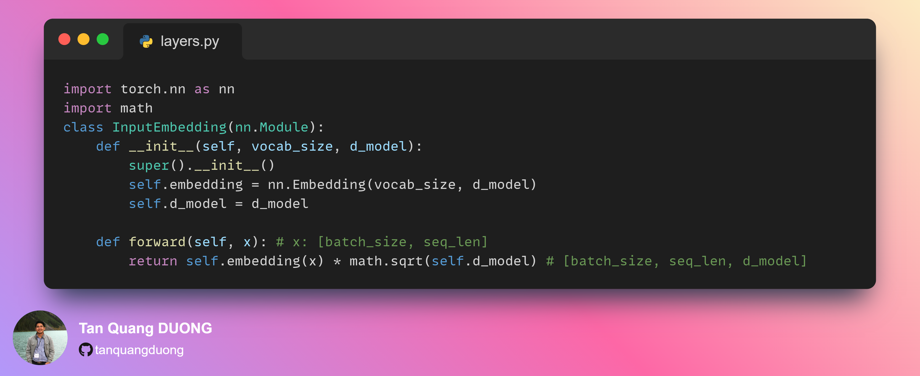
Layers-Input Embedding

Slide 19
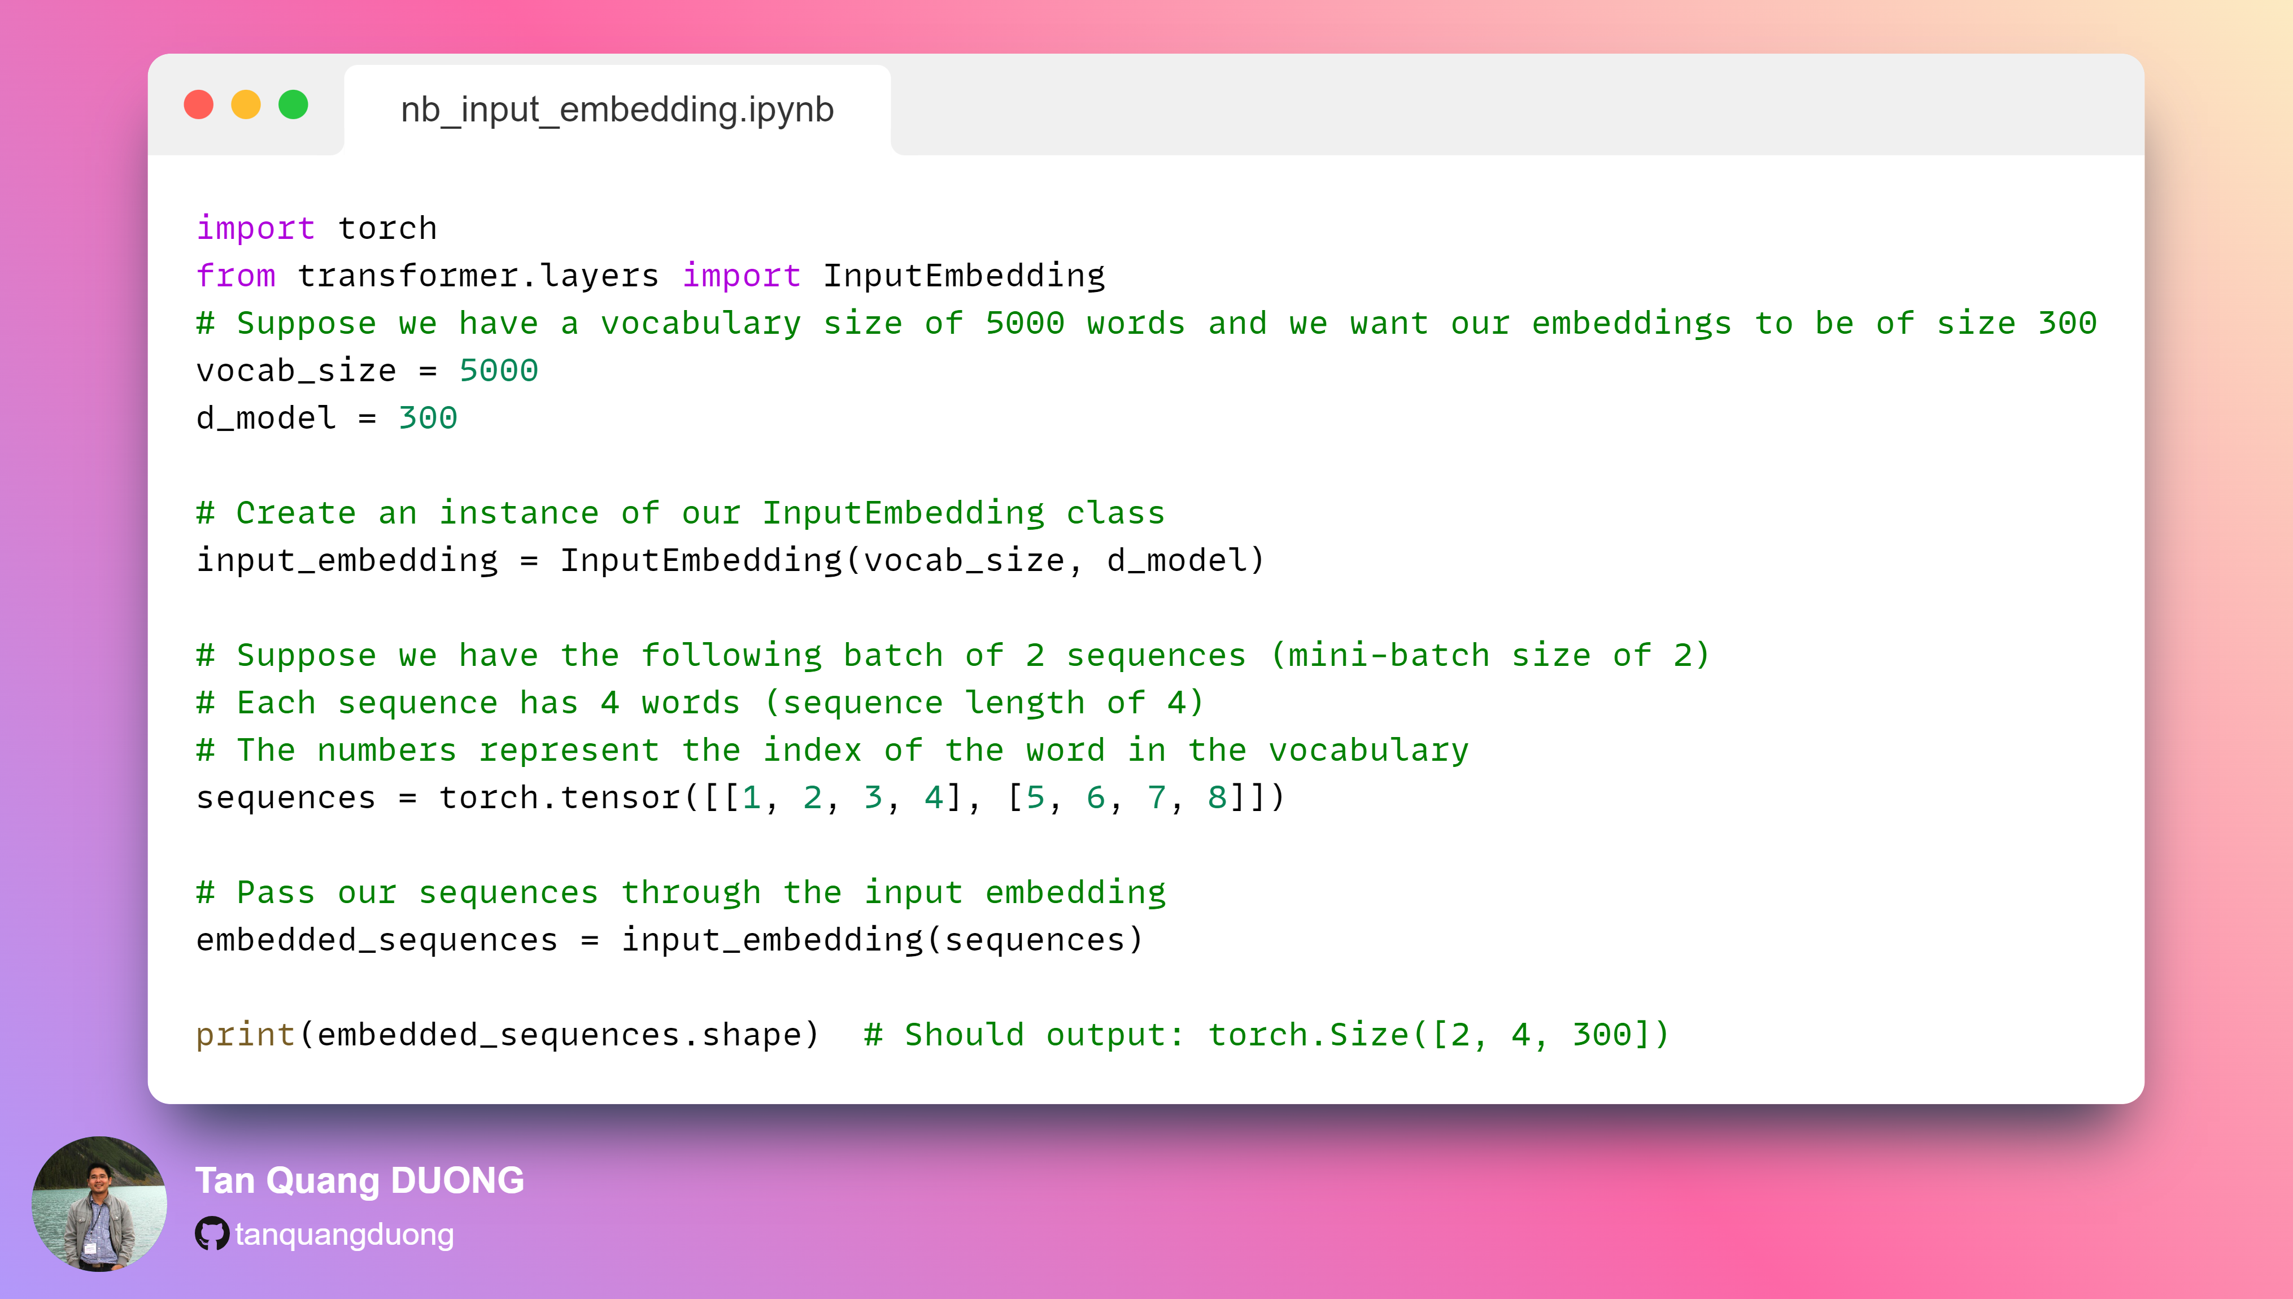
Input Embedding Notebook

Slide 20

